Slide 1

THE AMAZON-ING RACE
Suchit Das, Anant Gupta, Vinay Pahwa, Ishan Patel, and Rahul Singla

Slide 2

PROBLEM STATEMENT
Amazon sellers do not have in-depth analysis on the performance of their product Amazon buyers cannot differentiate products based on multiple preferences

Slide 3
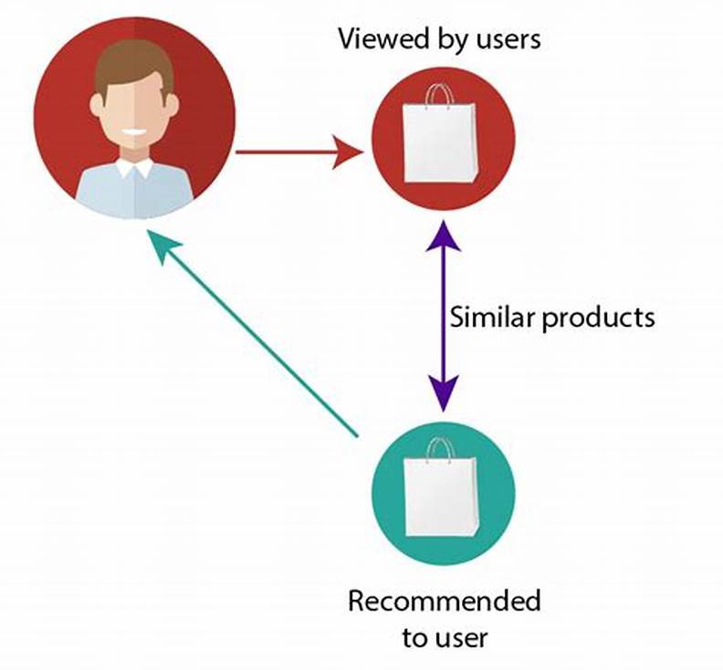
IMPORTANCE
BUYER
SELLER
QUICK
ENHANCE SALES & AVERAGE ORDER VALUE
TAILORED
CUSTOMIZED AND RELEVANT CONTENT
CONSISTENT BRAND EXPERIENCE
CONTENT BASED FILTERING
Notes:
Compare reviews from multiple products to provide the best choices for a consumer

Slide 4
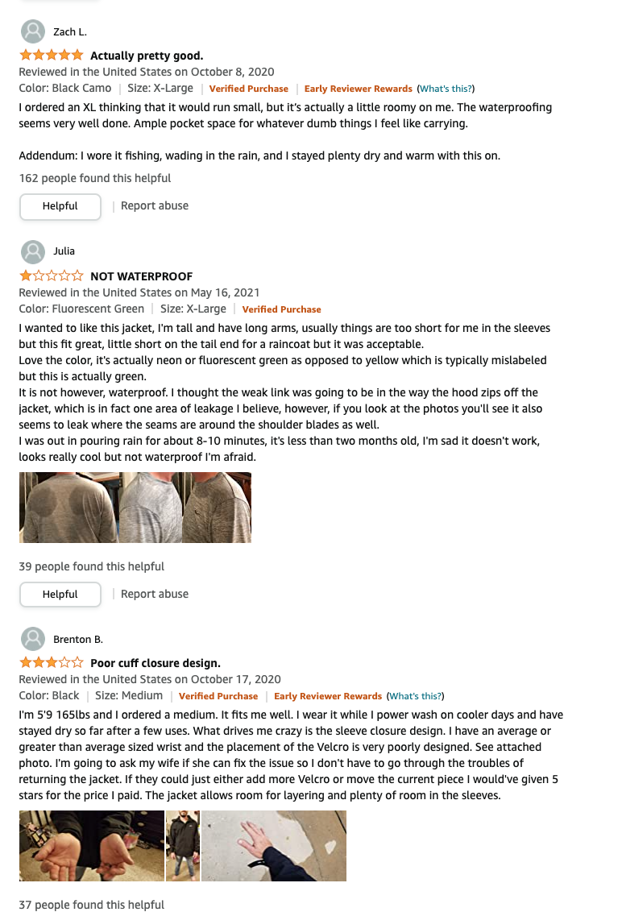

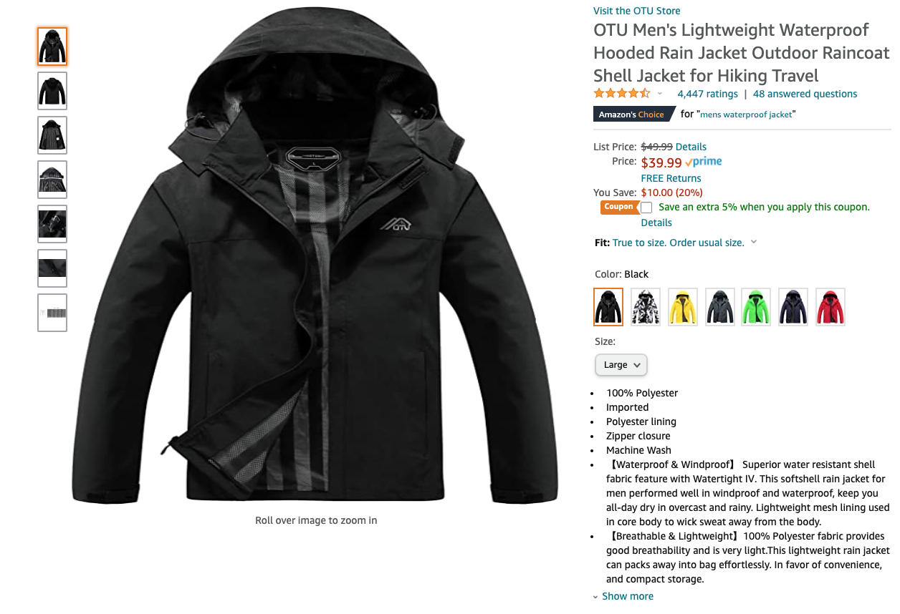
DATA
Notes:
When scrapping, we took into account the URL off of Amazon, the product name, product description, review title, and review it self

Slide 5

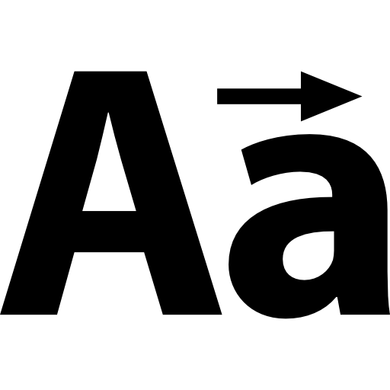

DATA CLEANING
Combined like terms
Made all characters lowercase
Removed '\n' & '\t' characters
Notes:
Cleaned the data by combining like terms (zipped and zip, etc.), made everything lowercase, and removed new line and tab indicators
First put the reviews into a word vectorizer and cleaned them
Next sorted them based on the top words that appeared
Next did a VADER analysis on the words and got the sentiment on them
Next did a Random Forest to get feature importance

Slide 6
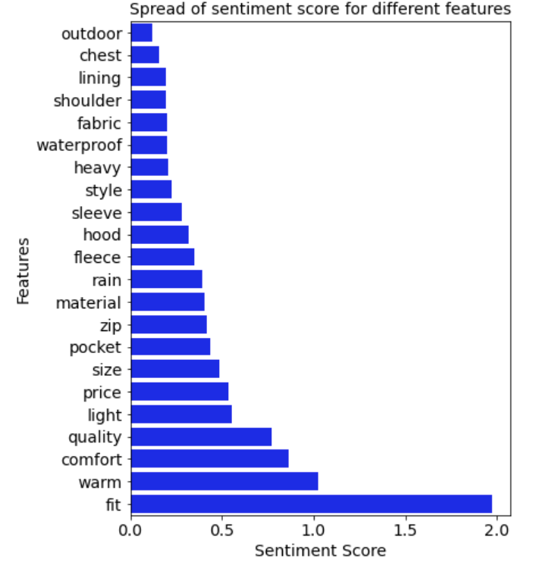
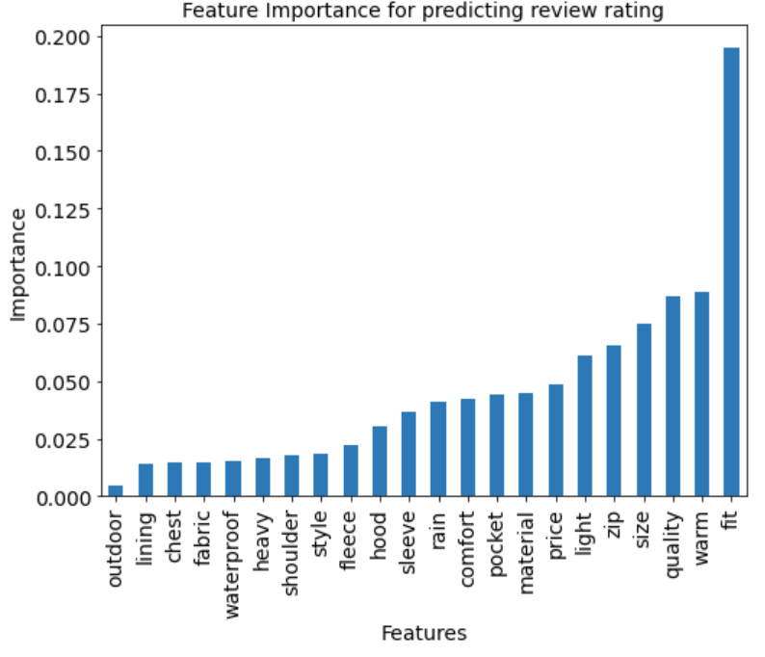
RESULTS - FEATURES
Notes:
Overall feature importance scores
Show that fit is the most important factors taken into account for reviews and the sentiment variation for them
Outdoor is the least
We can see that both graphs directly relate as the more the s.d. is for a feature, the higher the importance of that feature in reviews by customers
Use this on the sellers side to determine how to tailor products to attract more consumers
Use this on the buyers side to see how often a certain feature is talked about to see if your preference is talked about a lot and see if it is worth looking into the product or not

Slide 7
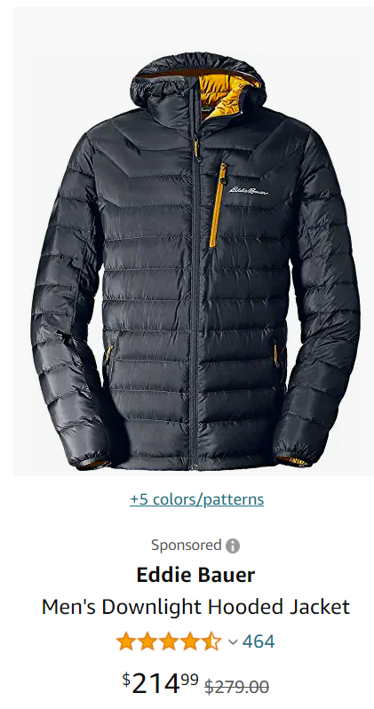
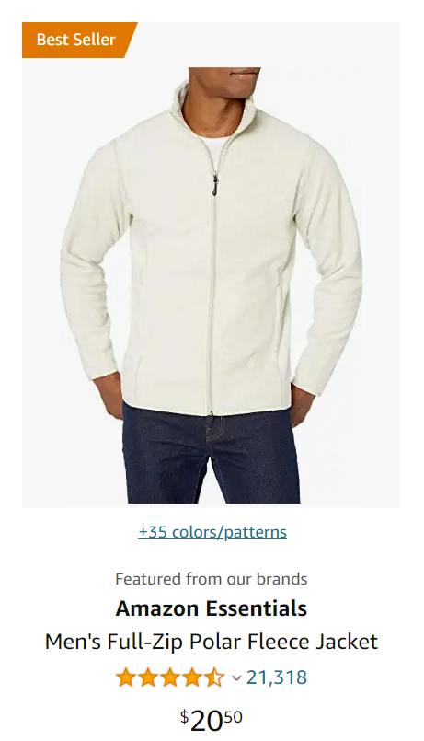
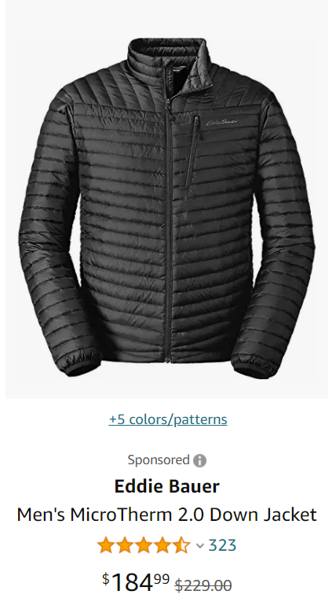
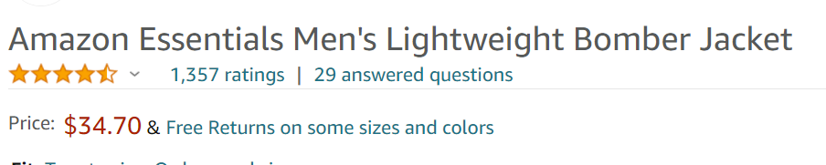
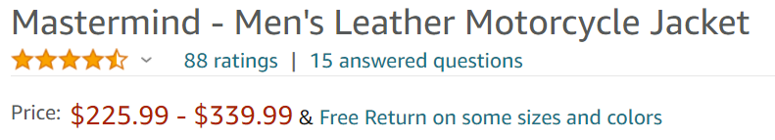
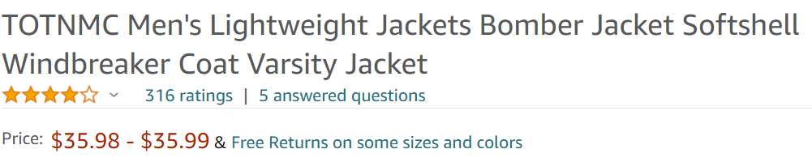
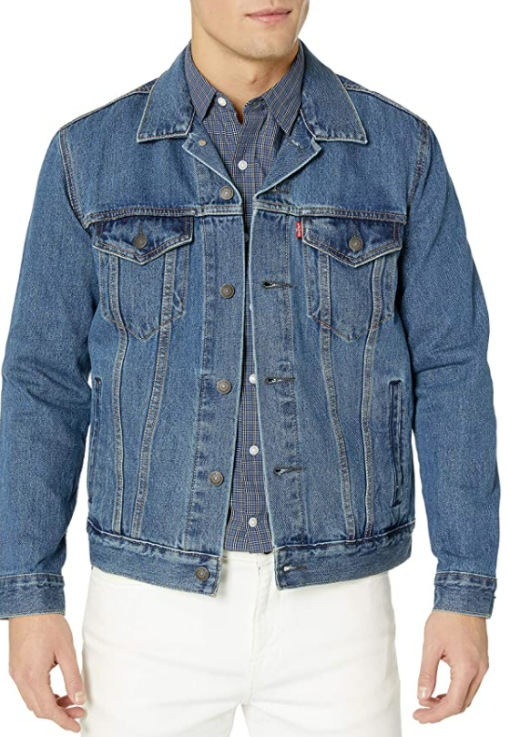
RESULTS – PRODUCT RECOMMENDATIONS
Levi's Men's Trucker Jacket
Negative reviews on Amazon:
Bad fittings and worse sticking
Feature | Sentiment score
Fit | 3.14
Quality | 0.24
Size | 0.18
Notes:
The recommendation is made by the algorithm based on customer preference. The algorithm accepts a total of 22 features and each feature can be weighted differently based on customer preferences. This will provide the customer unique ability to tweak the products according to their requirement.

Slide 8
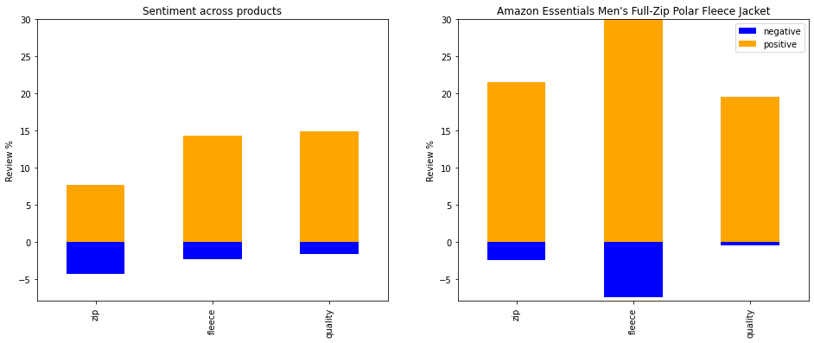
RESULTS – SELLER'S PERSPECTIVE
Notes:
The left graph shows the sentiment a seller may see across all their products while the right is specific to one product
This can be used to show to a seller how individual products are faring against the market. Here we are looking at the sentiments for 3 features for all jackets namely zip, fleece and quality. Both the features of zip and quality, the Amazon features has lower negative sentiment when compared across products but in case of Fleece feature, it has a higher negative sentiment which the seller can leverage to shore up the revenues

Slide 9

INSIGHTS
Sellers: Can directly compare products between themselves to competitors and adjust their products Buyers: Can get more customized outputs based on their specific preferences

